Slide 1
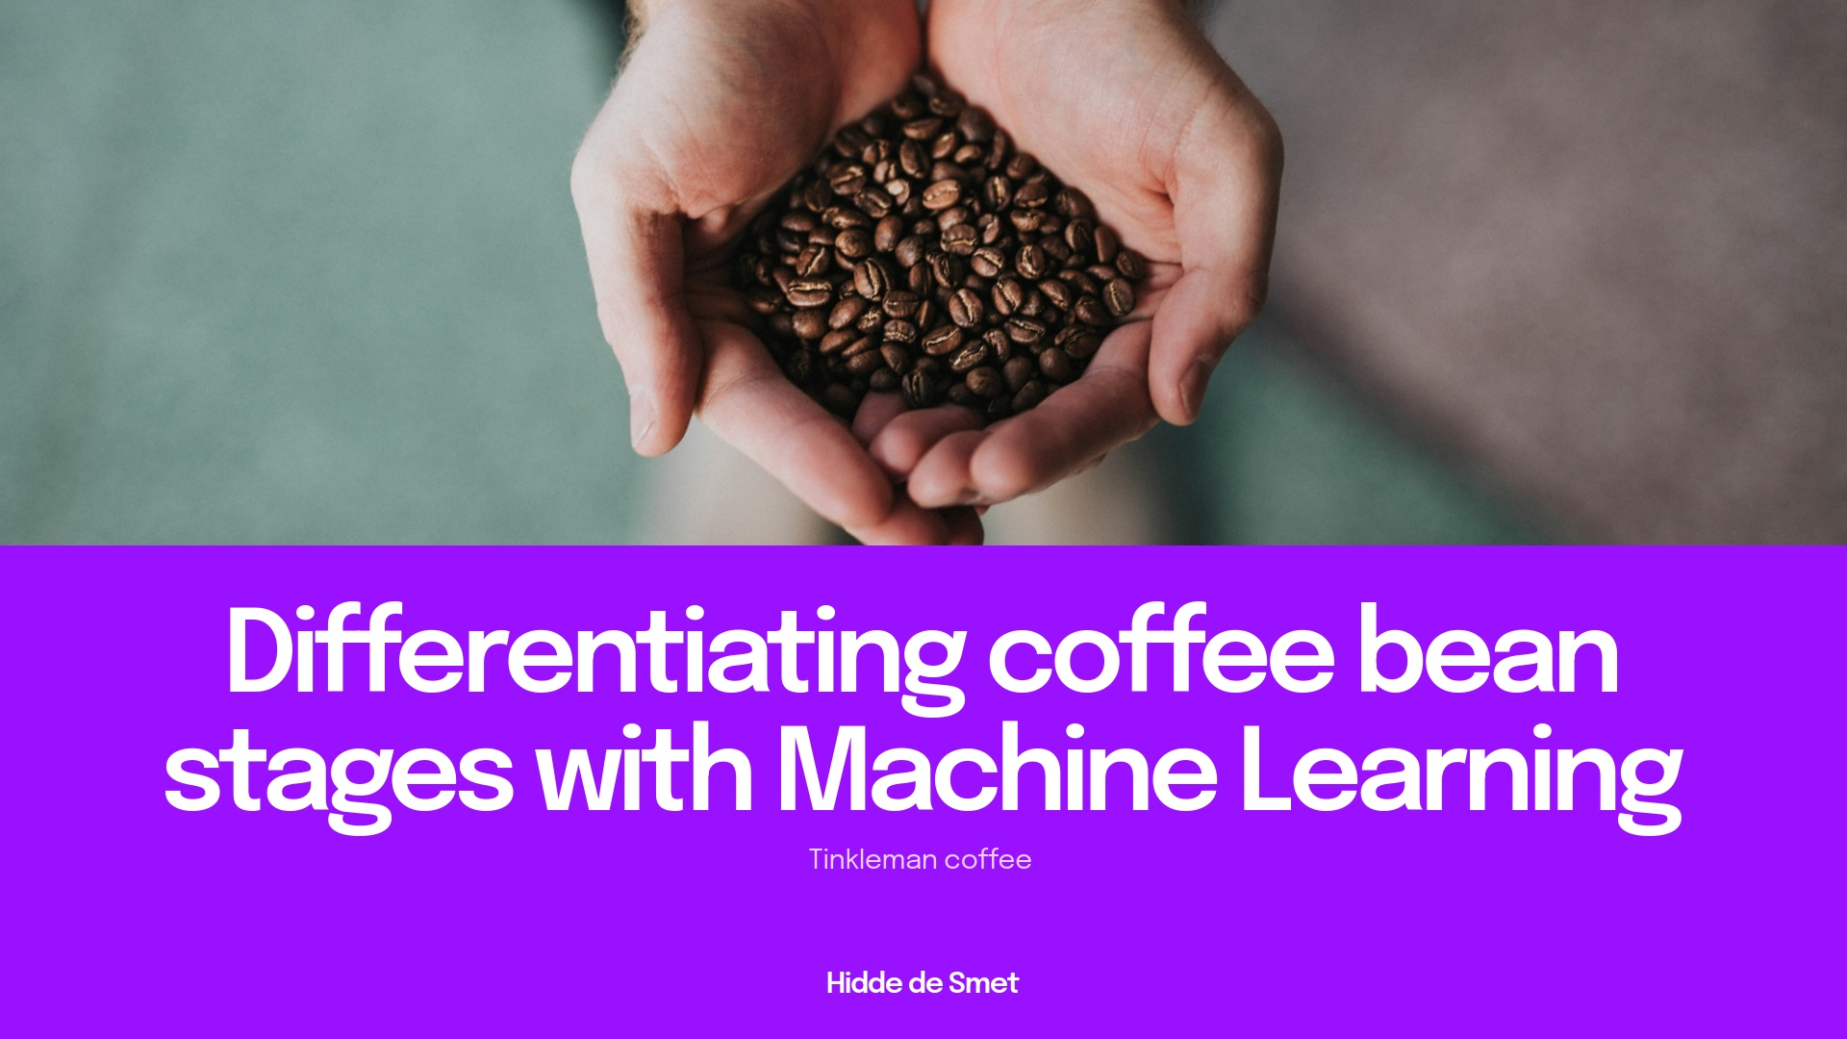
Notes:
Why: Start by welcoming the audience and introducing the topic. Explain that coffee beans go through different stages during roasting, and identifying these stages is important for making good coffee. Many companies do this by hand, but it can be slow and inconsistent. Machine learning is a way for computers to learn from examples and help automate this process, making it faster and more reliable.How: Tell the audience that you will show how machine learning can be used to look at pictures of coffee beans and decide what stage they are in. Mention that this can help the company make better coffee and save time. Let them know you will explain each step, even if they have never worked with machine learning before.Extra: We use machine learning because it can look at lots of pictures very quickly and doesn't get tired or distracted like people do. For example, if you had to sort hundreds of photos of beans, you might make mistakes after a while, but a computer can keep going and be consistent every time. This helps make sure every cup of coffee tastes the way it should.

Slide 2
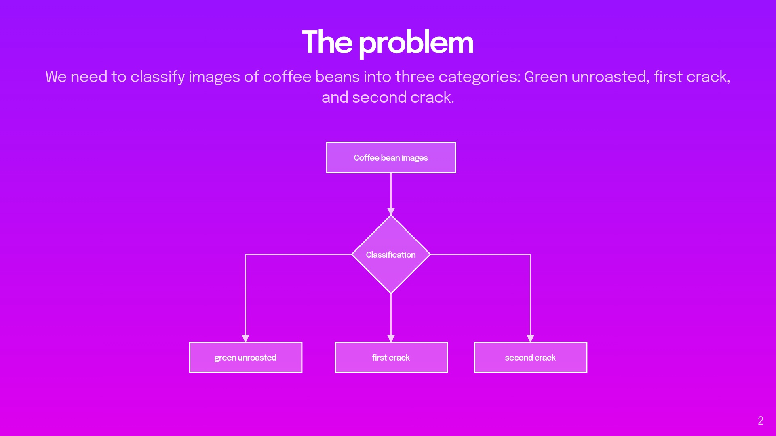
Notes:
Classification is a type of supervised learning where the goal is to sort data into categories or "classes."For example: You give a model pictures of animals labeled as "cat" or "dog." The model learns from those examples and then tries to guess if a new picture is a cat or a dog.So it's about choosing the right label for something based on what it has learned.Why: Explain that the main challenge is to look at a photo of coffee beans and figure out which stage they are in. Each stage changes the flavor and quality of the coffee. Doing this by eye can be hard, especially when you have a lot of beans to check.How: Show the diagram and point out that we want to sort beans into three groups: green (not roasted), first crack (partially roasted), and second crack (more roasted). Explain that the differences can be subtle, so we need a smart system to help.Extra: We use images because it's much easier and faster to take a photo than to check each bean by hand. For example, imagine a conveyor belt with beans passing by—a camera can snap pictures and the computer can sort them instantly. This saves time and helps avoid mistakes that can happen if someone is tired or in a hurry.

Slide 3
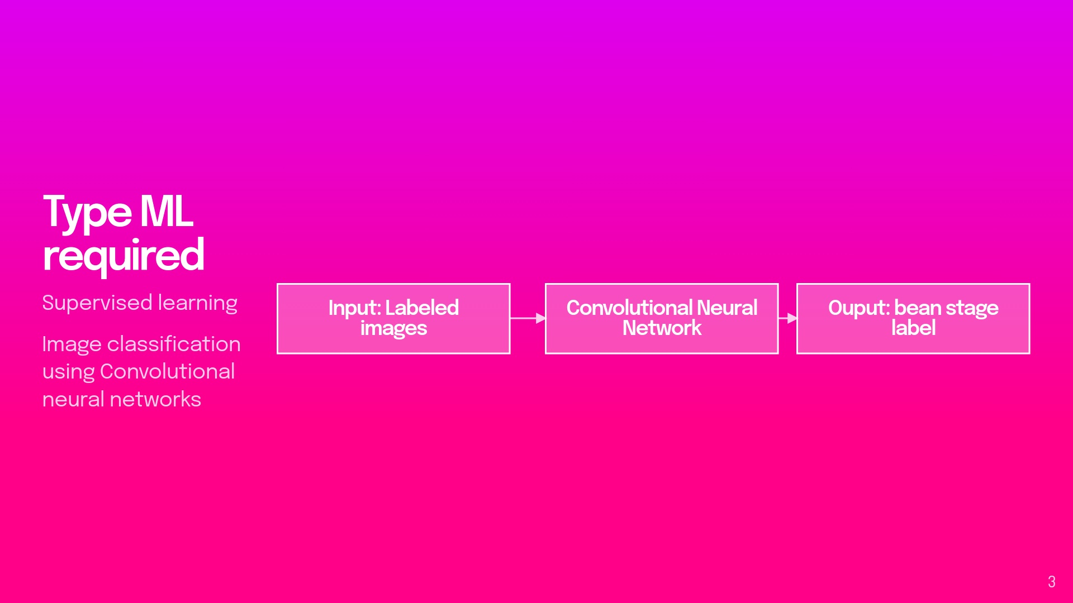
Notes:
Machine learning is a way for computers to learn from examples instead of being told exactly what to do. You give the computer lots of data, and it finds patterns and makes predictions based on what it learned.There are three main types of machine learning: Supervised learning – The model learns from labeled data (you give it questions and answers). Example: predicting house prices from size and location. Unsupervised learning – The model finds patterns in unlabeled data (just the data, no answers). Example: grouping customers by shopping behavior. Reinforcement learning – The model learns by trial and error, getting rewards or penalties. Example: teaching a robot to walk or a game agent to win. A CNN (Convolutional Neural Network) is a special type of neural network that's really good at understanding images.It works by automatically finding important patterns like edges, shapes, or textures in a picture — kind of like how our eyes and brain recognize objects.Example: A CNN can learn to tell the difference between photos of cats and dogs by focusing on features like ears, noses, and fur patterns.Why: Introduce the idea of machine learning. Supervised learning means we show the computer lots of examples where we already know the answer, so it can learn to recognize patterns.How: Explain that we use a special kind of computer program called a Convolutional Neural Network (CNN) that is very good at looking at pictures. We give it many images of beans, each labeled with the correct stage, and it learns to tell them apart. The diagram shows how labeled images go in, and the model learns to give the right label as output.Extra: We use supervised learning because it's like teaching a child with flashcards—"this is green, this is first crack, this is second crack." The CNN is chosen because it's like giving the computer special glasses that help it see shapes and colors in pictures. For example, if you show it enough photos of green beans, it learns what makes them different from roasted ones.

Slide 4
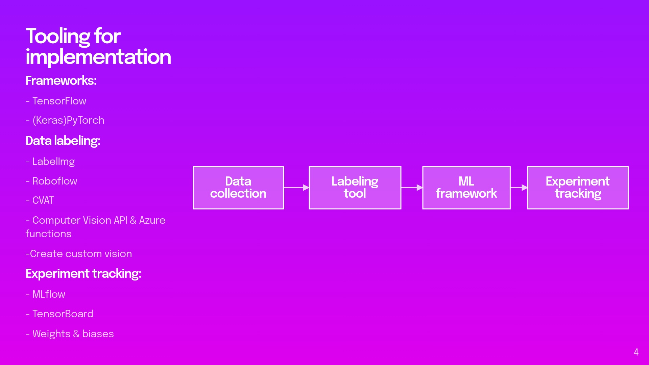
Notes:
Why: Introduce the idea of machine learning. Supervised learning means we show the computer lots of examples where we already know the answer, so it can learn to recognize patterns.How: Explain that we use a special kind of computer program called a Convolutional Neural Network (CNN) that is very good at looking at pictures. We give it many images of beans, each labeled with the correct stage, and it learns to tell them apart. The diagram shows how labeled images go in, and the model learns to give the right label as output.Extra: We use supervised learning because it's like teaching a child with flashcards—"this is green, this is first crack, this is second crack." The CNN is chosen because it's like giving the computer special glasses that help it see shapes and colors in pictures. For example, if you show it enough photos of green beans, it learns what makes them different from roasted ones.Experiment tracking is a way to keep track of everything you try when training a machine learning model — like what settings (hyperparameters), data, code version, and results you used.It helps you compare different runs, find out what worked best, and reproduce results later.Think of it like a scientist’s lab notebook — but for machine learning.Would you like examples of tools used for this?

Slide 5
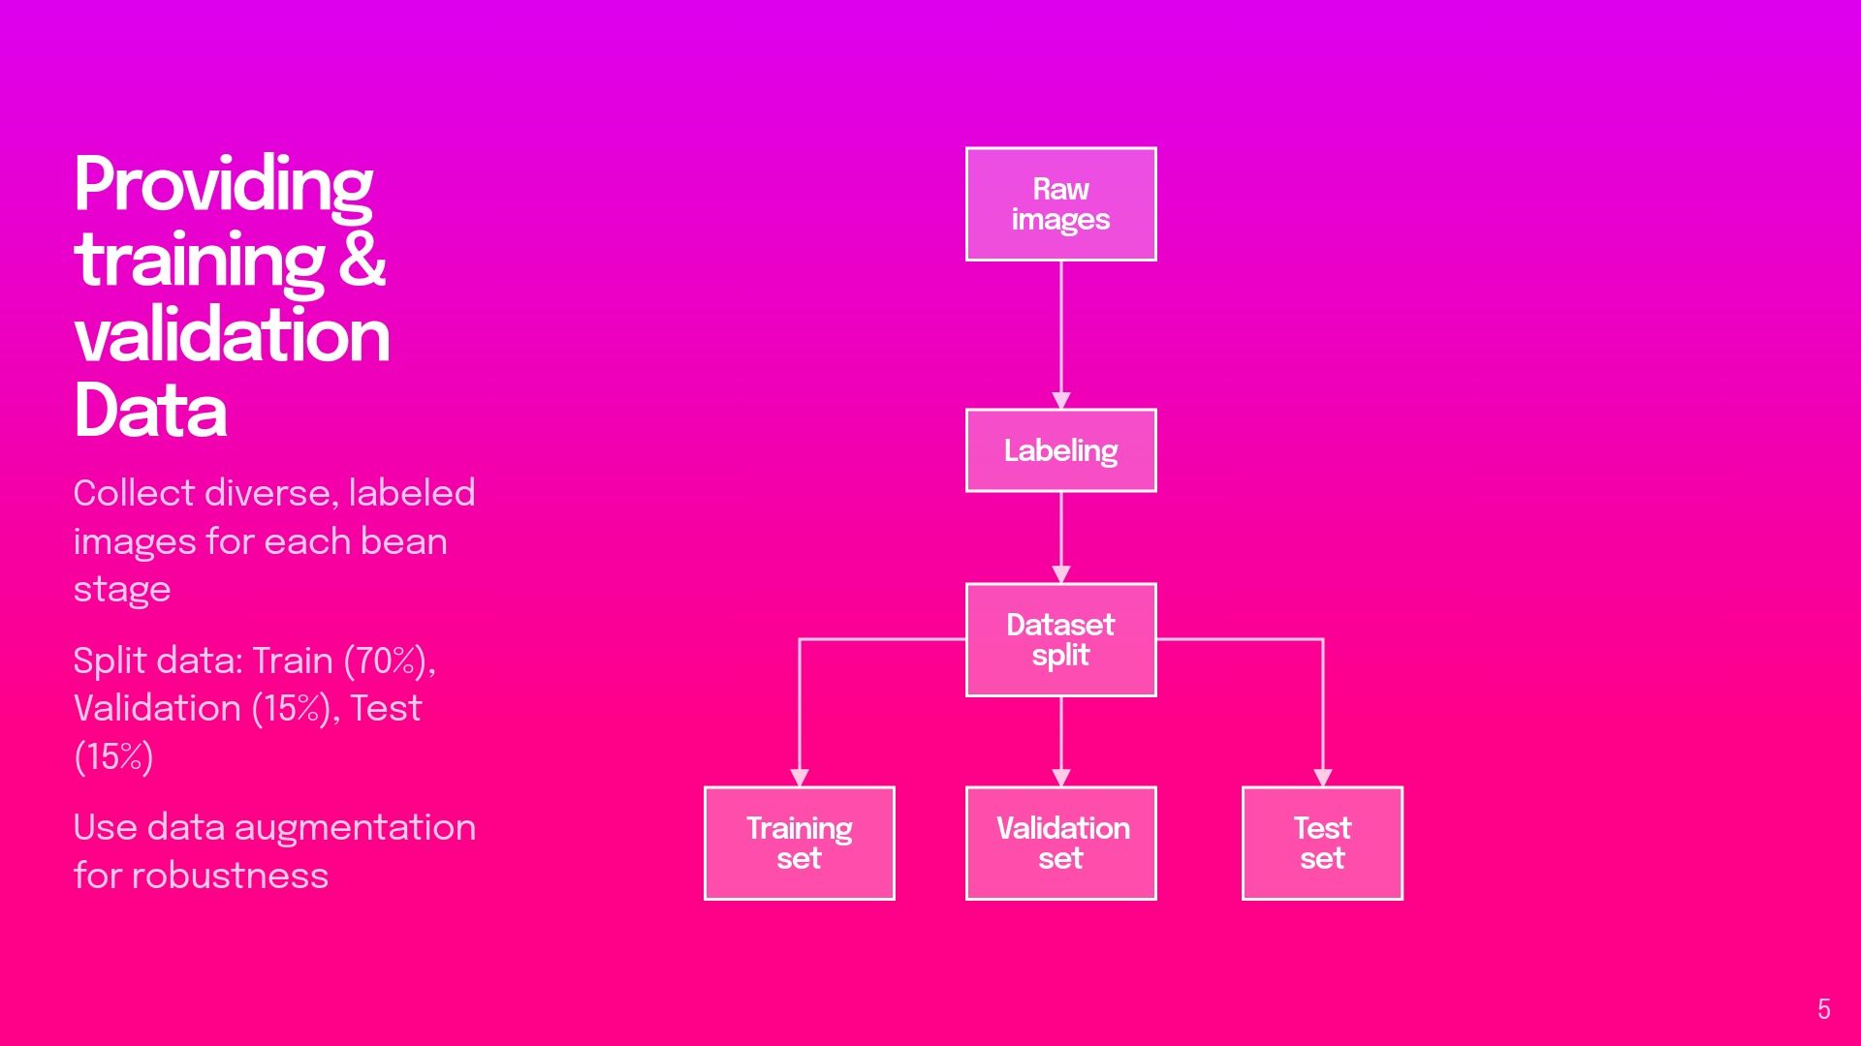
Notes:
Why: The computer needs to see lots of different examples to learn well. If we only show it one kind of bean or lighting, it won't work in real life. Splitting the data helps us check if the computer is really learning or just memorizing.How: Collect as many photos as possible, showing beans in different lighting, angles, and backgrounds. Label each photo with the correct stage. Split the photos into three groups: one for teaching the computer (training), one for checking its progress as it learns (validation), and one for testing it at the end (test). Data augmentation means making small changes to the photos—like flipping or brightening them—so the computer learns to handle variety.Extra: We split the data so the computer doesn't just "cheat" by memorizing the answers. For example, if you only ever see one kind of green bean, you might think all green beans look the same, but in real life, they can look different. Data augmentation is like showing the computer the same bean but with sunglasses, a hat, or in a different room—so it learns to recognize beans no matter what.

Slide 6
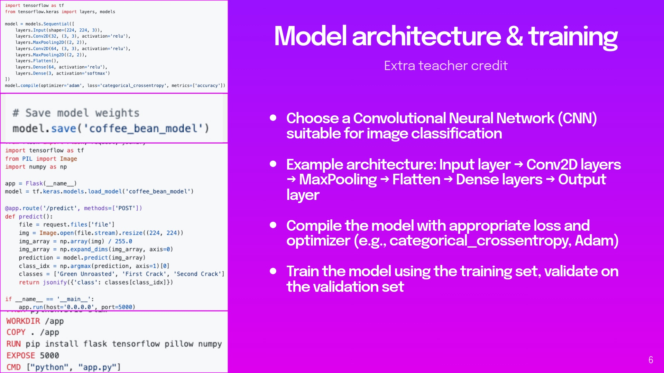
Notes:
The code implements a CNN for coffee bean image classification. Let's explore why each element was chosen:Why a CNN for This Task?CNNs are specifically designed for image processing tasks because they:Preserve spatial relationships: Coffee beans have specific visual patterns at different roasting stages (color changes, texture differences) that CNNs can detect through their filter-based approachFeature extraction: Automatically learn relevant features without manual feature engineeringTranslation invariance: Can recognize beans regardless of their position in the imageWhy This Specific Architecture?Input Layer: layers.Input(shape=(224, 224, 3))Why 224×224? Standard size that balances detail preservation with computational efficiencyWhy 3 channels? Captures RGB color information, essential for distinguishing roasting stages (green vs. brown tones)First Convolutional Layer: layers.Conv2D(32, (3, 3), activation='relu')Why 32 filters? Provides sufficient capacity to learn basic visual patterns without overfittingWhy 3×3 kernels? Small enough to capture fine details while being computationally efficientWhy ReLU? Introduces non-linearity without the vanishing gradient problem of other functionsMaxPooling Layers: layers.MaxPooling2D((2, 2))Why pooling? Reduces dimensionality while keeping dominant featuresWhy max pooling? Preserves important edge features better than average poolingWhy 2×2? Reduces dimensions by half without losing too much informationSecond Convolutional Layer with More Filters: layers.Conv2D(64, (3, 3), activation='relu')Why more filters in deeper layers? Detects more complex patterns after initial feature extractionWhy continue with 3×3? Maintains consistent feature extraction approachFlatten Layer: layers.Flatten()Why flatten? Converts 2D feature maps to 1D to connect with fully connected layersWhy at this point? After sufficient feature extraction but before classificationDense Layer: layers.Dense(64, activation='relu')Why 64 neurons? Provides sufficient capacity to learn complex combinations of featuresWhy ReLU again? Maintains consistent non-linearity benefits throughout the networkOutput Layer: layers.Dense(3, activation='softmax')Why 3 neurons? One for each coffee bean classification categoryWhy softmax? Produces probability distribution across classes, ensuring outputs sum to 1Compilation SettingsWhy Adam optimizer? Adapts learning rates for each parameter, making training more efficientWhy categorical crossentropy? Appropriate loss function for multi-class classificationWhy accuracy metric? Intuitive measure of performance for classification tasksThis architecture balances complexity and efficiency—complex enough to distinguish subtle differences between bean stages, yet simple enough to train efficiently and avoid overfitting with limited training data.This Dockerfile creates a container image for a Python application, likely focused on machine learning with TensorFlow. Let me explain each part:The Dockerfile starts with FROM python:3.10-slim as the base image, which provides Python 3.10 in a lightweight container that has minimal additional packages. This helps keep the final image size smaller compared to using the full Python image.WORKDIR /app sets the working directory inside the container to /app, which means all subsequent operations will occur in this directory unless specified otherwise.COPY . /app copies all files from the current directory on your host machine (where you're building the Docker image) into the /app directory in the container. This includes your application code and any other necessary files.RUN pip install flask tensorflow pillow numpy installs the required Python packages:Flask: A lightweight web framework for creating the application's APITensorFlow: A popular machine learning libraryPillow: A library for image processingNumPy: A library for numerical computationsEXPOSE 5000 informs Docker that the container will listen on port 5000 at runtime. This is the default port for Flask applications, suggesting this container will run a web service.Finally, CMD ["python", "app.py"] specifies the command to run when the container starts - it will execute app.py using Python. This file presumably contains the Flask web application that might serve machine learning predictions, likely related to coffee beans given the filename context.

Slide 7
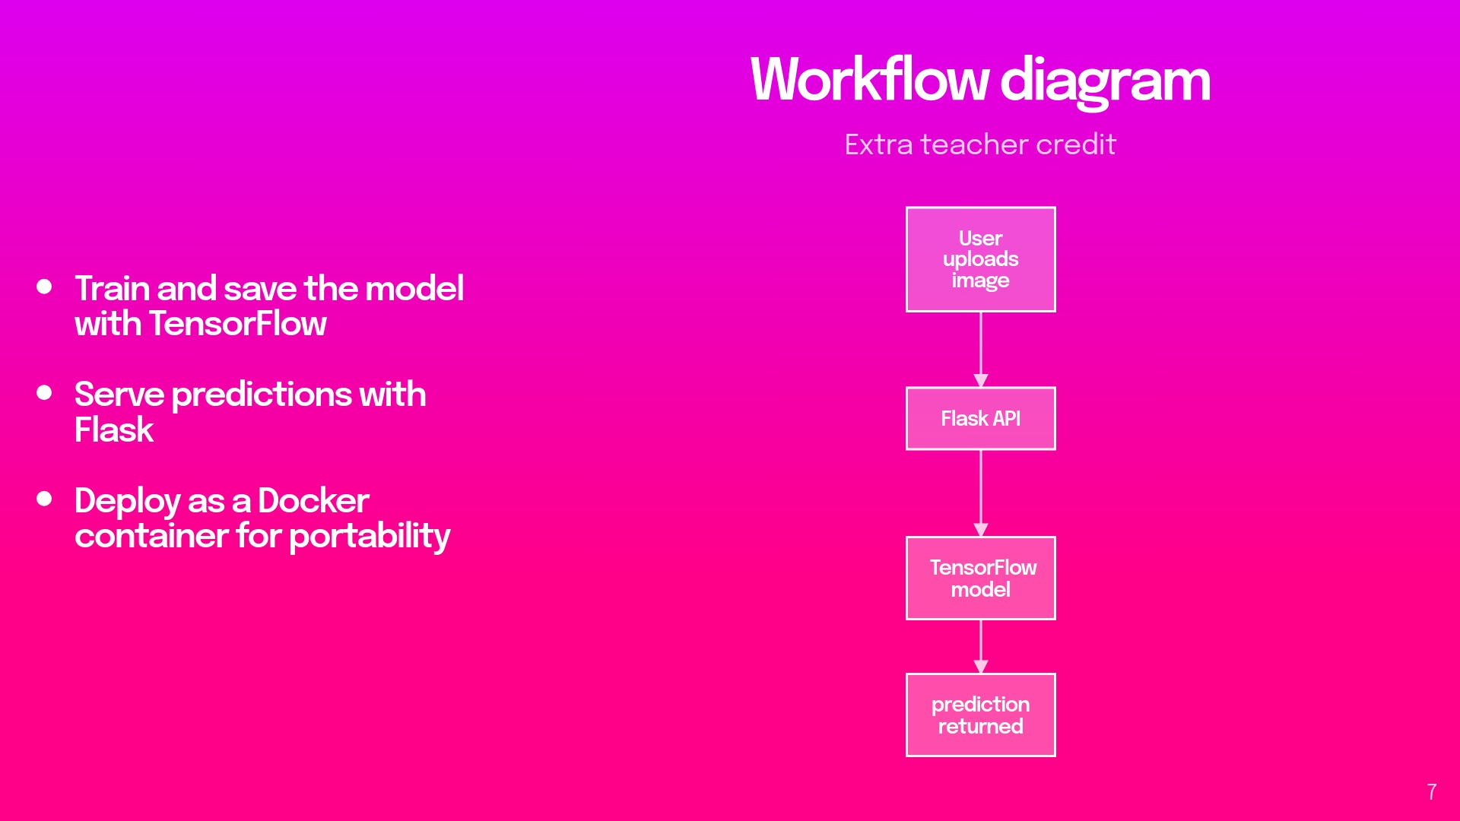
Notes:
The flow explainedUser uploads image: The process begins when a user (like a barista or coffee roaster) takes a photo of coffee beans and uploads it to the system through an app or web interface.Flask API processes request: The uploaded image is received by a Flask web service running in a Docker container. This API acts as the interface between users and the AI model, handling the HTTP requests and preparing images for analysis.TensorFlow Model analyzes image: The containerized TensorFlow model, which was previously trained on thousands of labeled coffee bean images, analyzes the new image. It examines visual patterns like color, texture, and shape to determine the roasting stage.Prediction returned: After analysis (which takes milliseconds), the model returns its prediction about whether the beans are:Green unroastedFirst crack stageSecond crack stageThis represents a complete machine learning inference pipeline that takes raw input (images) and provides actionable insights (bean classification) to users.

